Slide 1
SPM ONLINE DEMO
G6T6
Zheng Yang
Maurice
Sebastian
Sujuan
Zican

Slide 2
TABLE OF CONTENTS
01
04
FUNCTIONALITIES
BUG METRICS
02
05
BUG LOG
SCHEDULE
03
06
ROLES & RESPONSIBILITIES
Q&A

Slide 3
COMPLETED
FUNCTIONALITIES BEFORE PM REVIEW
Login
Bootstrap
Add Bid For Round 1

Slide 4
Functionalities Completed Since PM Review
Add Bid For Round 2
Drop Bid for Round 2
Drop Section For Round 2
Notes:
filter options for students
Bid result statistic = min, average, max like in BOSS
Course catalogue: Display all courses with filter options by school.

Slide 5
SCHEDULE
Iteration 1 Planning, Logi, Bootstrap & Round 1 Bid
Iteration 3 Round Controls, Round 2 Bid & Resolution, JSON Web Token & Round Controls
Iteration 5 Extra Features & Final Debugging
Iteration 2 Drop Bids, Round 1 Resolution , AWS Deployment
Iteration 4 Complete all JSON Web Service
Iteration 6 Final Presentation

Slide 6

SCHEDULE
No Changes :)

Slide 7





Iteration 1(Completed) Week 4 & 5 9/9/2019-9/22/2019
Planning
Bootstrap
Round 1 Bidding
Testing and Debugging
Creating DAO and Objects
For Web UI Excludes JSON Bootstrap
without input validation
Login

Slide 8





Iteration 2 (Completed) Week 6 & 7 9/23/2019 - 10/06/2019
Drop Bids & Section
Round 1 Resolution
Milestone #1
AWS Deployment
Testing and Debugging
Round 1 Clearing Logic
Week 7 PM Review
Bootstrap Add Bid
Drop Bid/Section
Round 1 Clearing Logic
Notes:
Need to change this

Slide 9


Iteration 3(In-Progress) Week 8 & 9 10/07/2019 - 10/20/2019
Round 2 Bidding
Round 2 Clearing Logic
Testing and Debugging
JSON Web Token
Web UI & JSON Round Controls
Milestone #2
Add Bid
Real Time Bid Results
Round 2 Bidding
Round 2 Clearing Logic
Week 9 Demo

Slide 10

Iteration 4 Week 10 & 11 10/21/2019 - 11/03/2019
JSON Bids
Milestone #3
JSON Table Dumping
Testing and Debugging
Week 11 UAT
JSON Functions
Notes:
JSON Bids for admin

Slide 11



Iteration 5 Week 12 & 13 11/04/2019 - 11/17/2019
Extra Features #1
Extra Features #2
Extra Features #3
Testing and Debugging
Milestone preparation
Coding a timetable
Bidding Statistics
Course Catalogue
Extra Functions
Final Debugging
Preparation for final presentation

Slide 12
Iteration 6 Week 14 11/18/2019 - 11/22/2019
Final Presentation

Slide 13
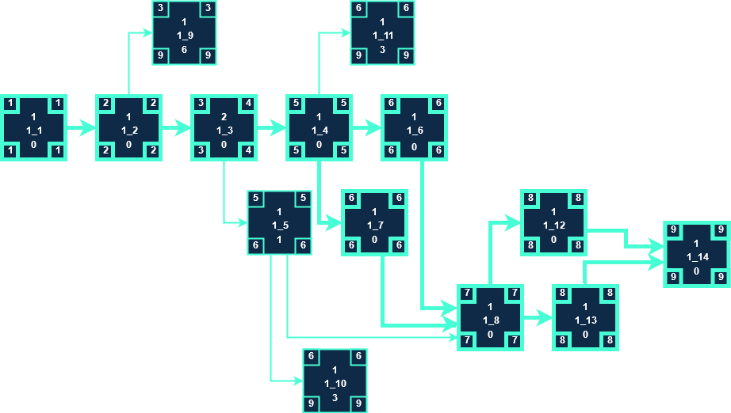
ITERATION 1 CRITICAL PATH (Completed)
Buffer Time:
14 - 9 = 5 Days

Slide 14
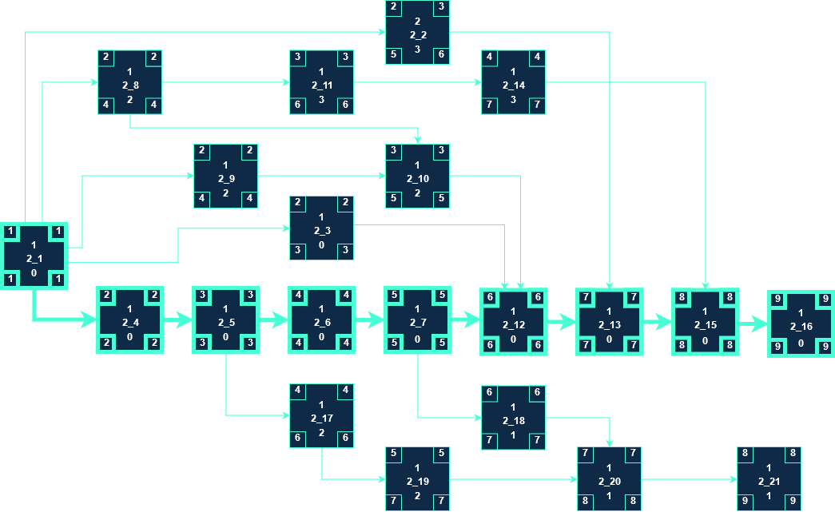
ITERATION 2 CRITICAL PATH (Completed)
Buffer Time:
14 - 9 = 5 Days
Notes:
highlight the critical path clearly

Slide 15
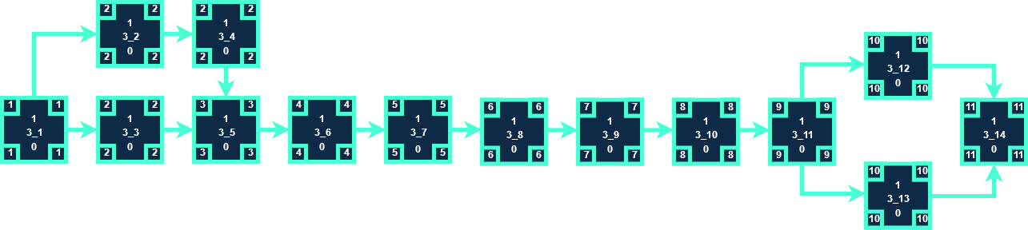
ITERATION 3 CRITICAL PATH (In-Progress)
Buffer Time:
14 - 11 = 3 Days
Notes:
highlight the critical path clearly

Slide 16
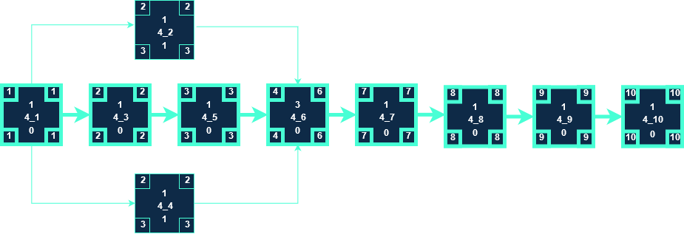
ITERATION 4 CRITICAL PATH
Buffer Time:
14 - 10 = 4 Days

Slide 17
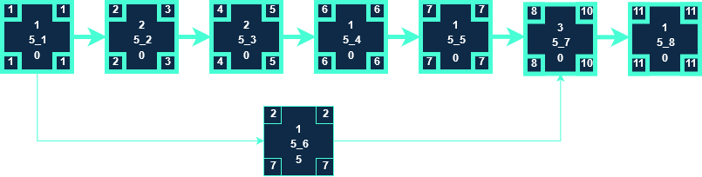
ITERATION 5 CRITICAL PATH
Buffer Time:
14 - 11 = 3 Days

Slide 18

ITERATION 6 CRITICAL PATH
Buffer Time:
5 - 4 = 1 Day

Slide 19
CLOUD DEPLOYMENT
IP address: 54.86.180.118/app
Admin Password: adminbios

Slide 20
Feedback Received from PM Review
Testcase excel sheet only contains results for latest testing session
Added additional columns for new testing sessions
More bugs than testcases
Added more testcases
Documented bugs correctly

Slide 21
BUG METRICS
Iteration | Current Value | Total value | Status
1 | 0 | 8 | Resolved
2 | 0 | 32 | Resolved
3 | 0 | 16 | Resolved

Slide 22
Bugs in Iteration 1(Resolved)
Functionality | Description | Severity | Points | Points Total
Login(User) | Successful login with incorrect username(case insensitive) and correct password | High | 5 | 8
Login(User) | Login page has undefined variable 'error' | Low | 1
Login(User) | Login page displayed error message "A session had already been started" | Low | 1
Bidding | Biding page displayed syntax error, unexpected '}' | Low | 1

Slide 23
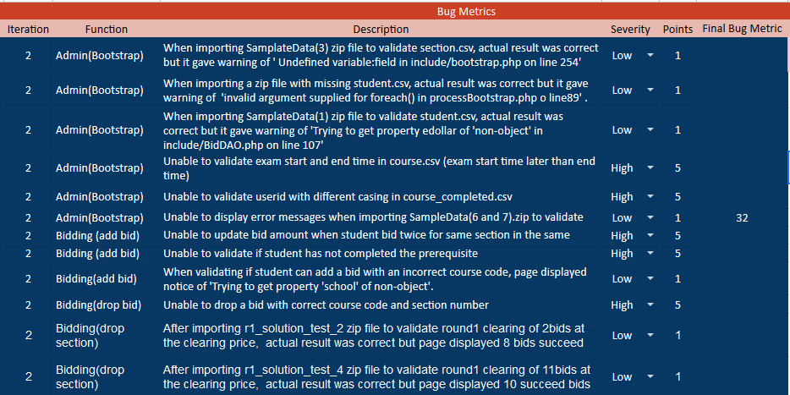
Bugs in Iteration 2

Slide 24
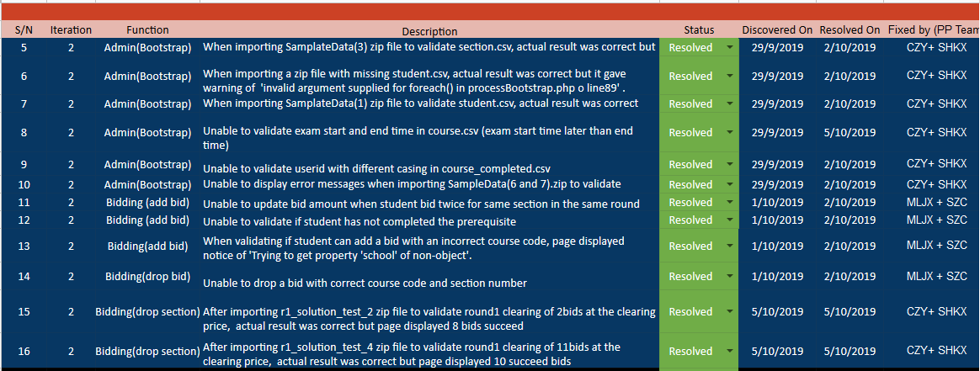
Bugs Log for Iteration 2 (Resolved)

Slide 25
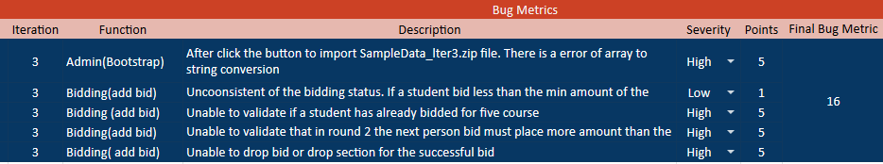
Bugs in Iteration 3

Slide 26
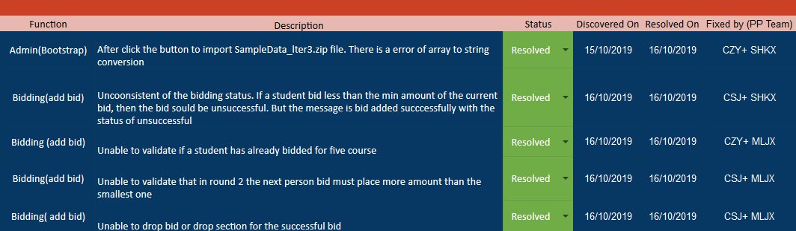
Bug Log for Iteration 3

Slide 27
ROLES & RESPONSIBILITIES (No Change)
PM | Milestones
SuJuan | PM Review (Week 7)
ZiCan | Application Demo and Progress Update (Week 9)
Maurice | User Acceptance Test (Week 11)
Sebastian | Final reviews, debugging and push
ZhengYang | Final Presentation (Week 14)

Slide 28
PM & PP ROTATION (No Changes)
PM
PAIR 1
PAIR 2
ITER | WEEK | CZY | CSJ | SZC | MLJX | SHKX
1 | 4 - 5
2 | 6 - 7
3 | 8 - 9
4 | 10 - 11
5 | 12 - 13
6 | 14

